Slide 1
Introduction to Big Data and Why R?
Instructors: George Ostrouchov and Nagaraj Neerchal
Authors: Nagaraj Neerchal, George Ostrouchov, Andrew Raim, and others

Slide 2
The Big Data V’s
Crowdsourced Data
Data collected for another purpose
Data from unrelated activity
Not based on a design
Volume
Bigger than Memory
Variety
Connecting Disparate
Data Sources
Validity
Veracity
Bias
Trustworthiness
Velocity
Streaming
Real Time
Volatility
Variability
Bursty arrival
Nonstationary

Slide 3

Tired of V’s . . . ?
Adapted from Drew Schmidt

Slide 4
Technology Brings More Data
Volume
Bigger than Memory
Variety
Connecting Disparate
Data Sources
Validity
Veracity
Bias
Trustworthiness
Velocity
Streaming
Real Time
Volatility
Variability
Bursty arrival
Nonstationary

Slide 5
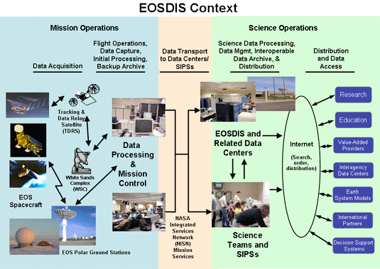
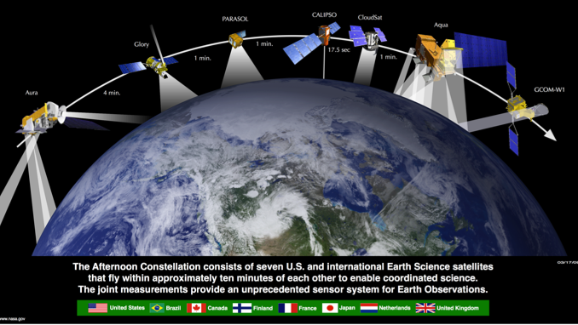
Satellite Sensors Produce Big Data
NASA: Earth Science Data and Information System (ESDIS) Project
3 TB per day
5+ PB archive
High space, low time resolution
Images from nasa.gov

Slide 6
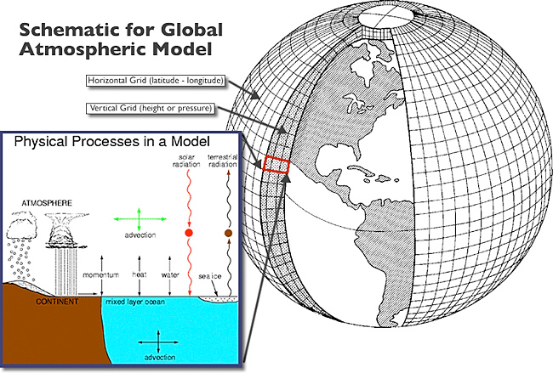

Simulations Produce Big Data
Earth System Models:
Atmospheric model
Ocean model
Sea ice model
Ice sheet models
Chemical transport models
Text
High resolution example:
20 variables
6 hour instantaneous
1 year ≈ 1 TB
Source: Wikimedia, PD-USGov-DOC-NOAA
Climate models are systems of differential equations based on the basic laws of physics, fluid motion, and chemistry.

Slide 7
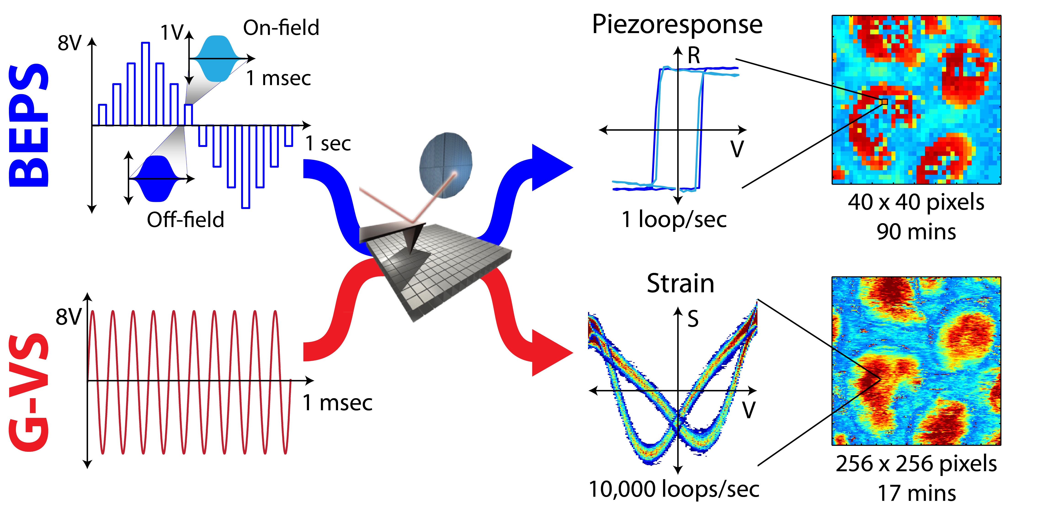
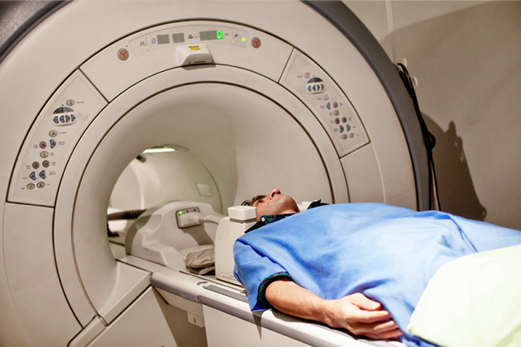
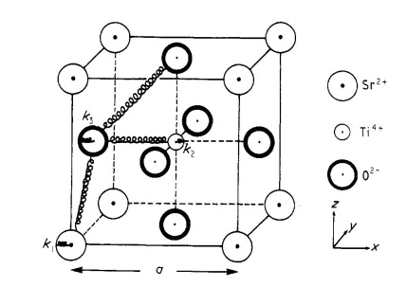
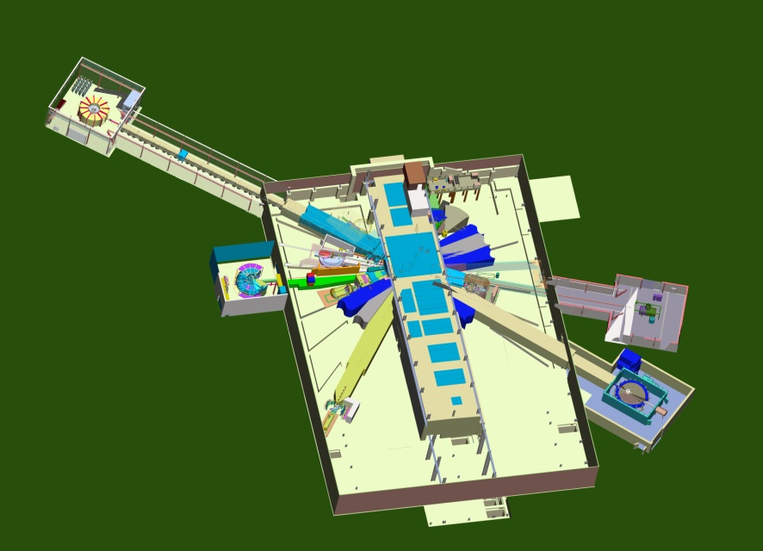
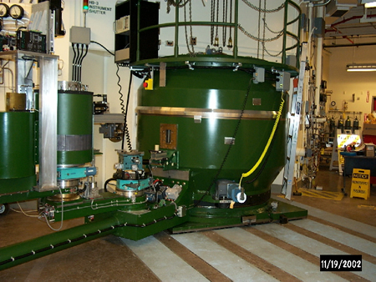
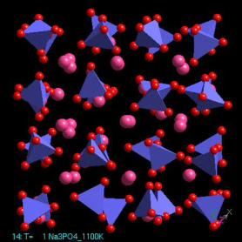
Laboratory Instruments Produce Big Data
Microscopy
Neutron science
Functional Magnetic Resonance Imaging
2 - Backscattering Spectrometer
1B - Disordered Mat’ls Diffractometer
18 - Wide Angle Chopper Spectrometer
PROTONS
17 - High Resolution Chopper Spectrometer
3 - High Pressure Diffractometer
4A - Magnetism Reflectometer
15 – Spin Echo
14B - Hybrid Spectrometer
4B - Liquids Reflectometer
13 - Fundamental Physics Beamline
5 - Cold Neutron Chopper Spectrometer
12 - Single Crystal Diffractometer
6 – Small Angle Scatt. Diffractometer
11A - Powder Diffractometer
9 - Engineering Diffractometer
60 m

Slide 8


Business Produces Big Data
Corporate accounting data
Corporate customer data
Credit card transactions
Wireless call connections
Real-time web advertising

Slide 9
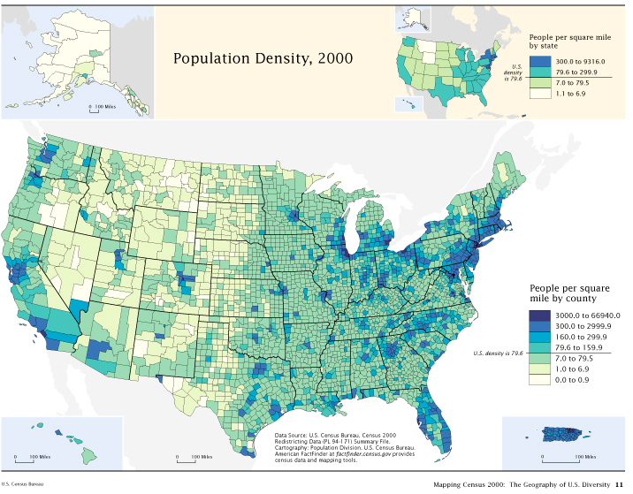
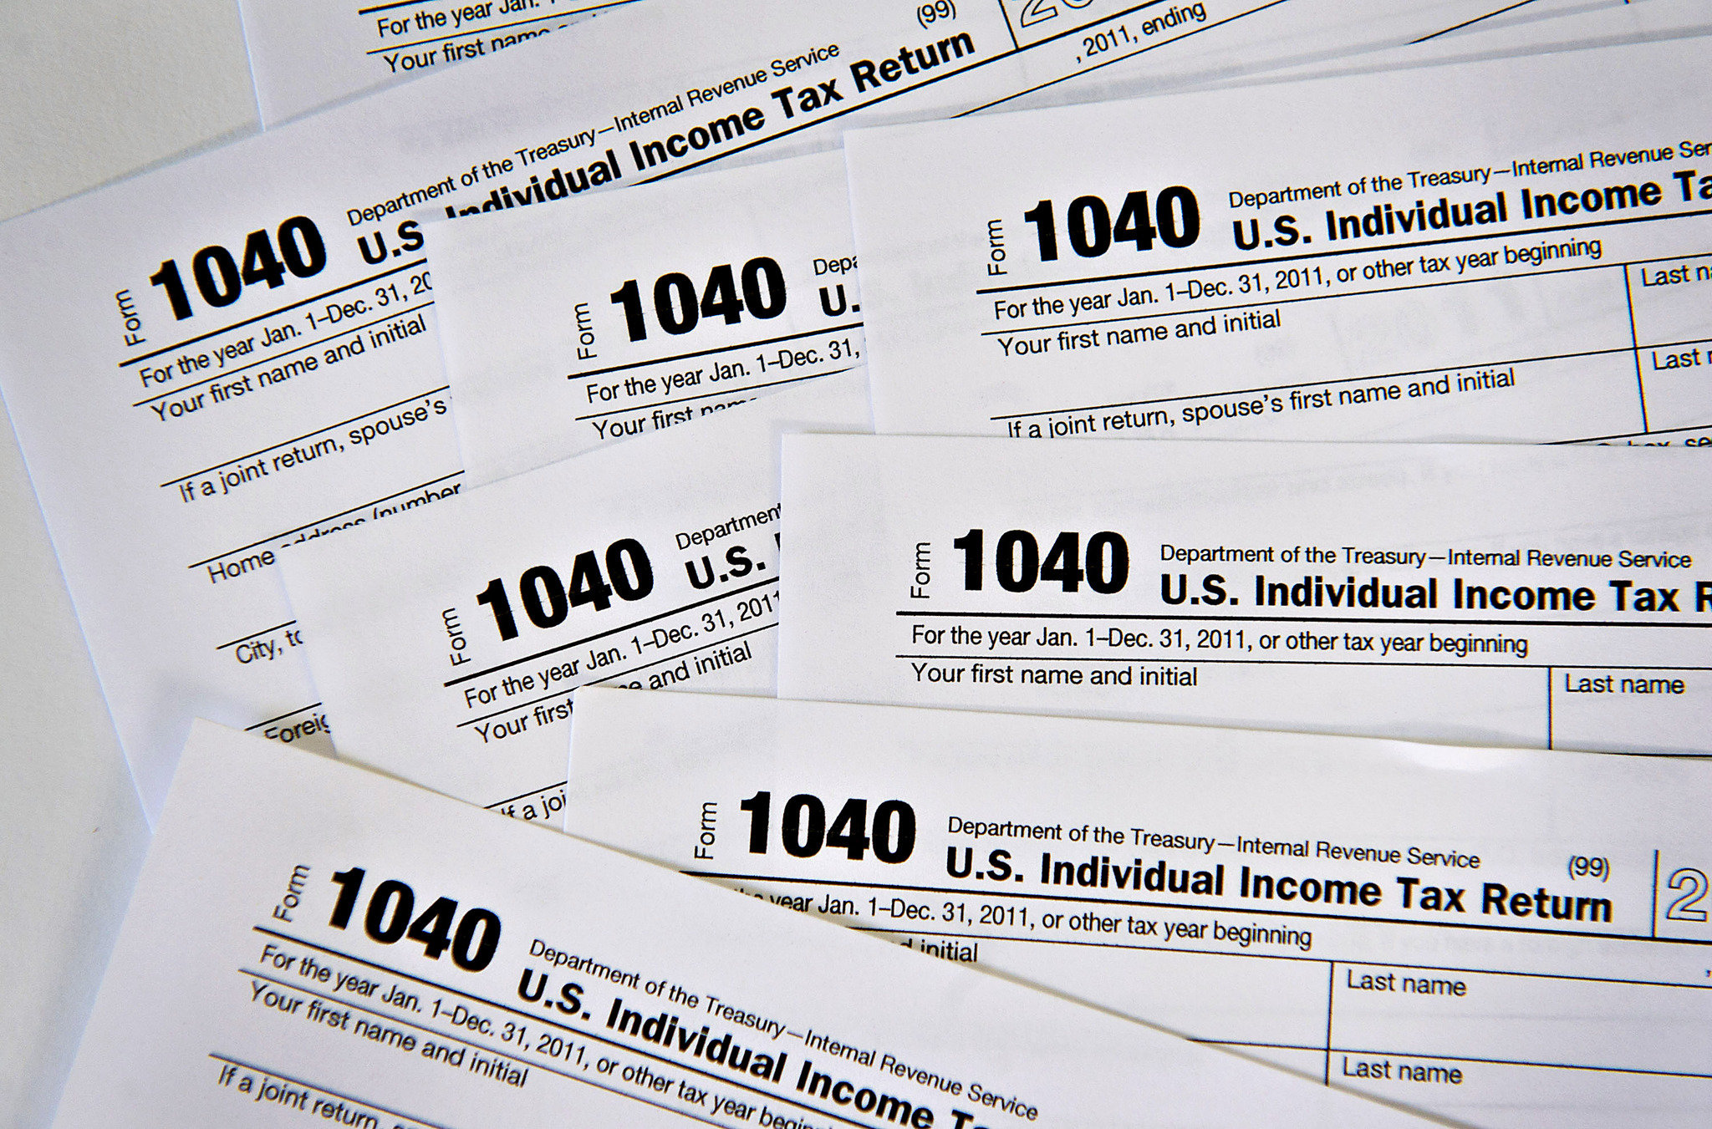
Government Produces Big Data
Census
Surveys
Economic data
Health data
Tax records

Slide 10




The Internet Produces Big Data
Google
Facebook
Crowdsourcing
Wikipedia
Stack Overflow
GitHub

Slide 11
When is data BIG?
When Size is an Issue in Handling It
Hero:
Practically impossible to move
Only approachable on largest computational platforms
Large:
Rather painful to move
Requires distributed parallelism
Medium:
Data won’t fit on local workstations
Generally have to process on “fat” SMP systems
Small:
Data is small enough to easily move anywhere
Analysis is generally done on local workstations
Hero
Large
Medium
Small
Adapted from Sean Ahern
Notes:
Today: Petabytes, Terabytes

Slide 12

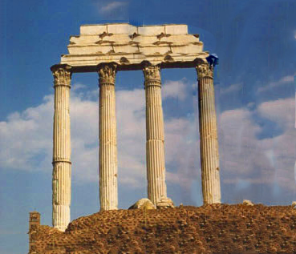
Data may be the “fourth pillar” of science
Computational
Data-driven
Theoretical
Experimental
Computer enabled
Or maybe NOT? Old pillars + technology!

Slide 13
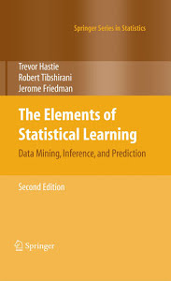
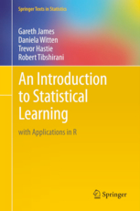
Statistical Learning or Machine Learning?
Both are about learning from data, some difference in emphasis:
SL: Understanding and discovery
ML: Processing and prediction
Glossary*
Machine Learning
Statistical Learning
Network, graph . . . . . . . . . . . . . . .
One-hot . . . . . . . . . . . . . . . . . . . . . .
Weights . . . . . . . . . . . . . . . . . . . . .
Learning . . . . . . . . . . . . . . . . . . . . .
Generalization . . . . . . . . . . . . . . . .
Supervised learning . . . . . . . . . . . .
Unsupervised learning . . . . . . . . . .
Model
Dummy variable
Parameters
Fitting
Test set performance
Regression/classification
Density estimation, clustering
* adapted from Rob Tibshirani, Stanford Department of Statistics
Notes:
SL older than ML. But physics older than either!

Slide 14
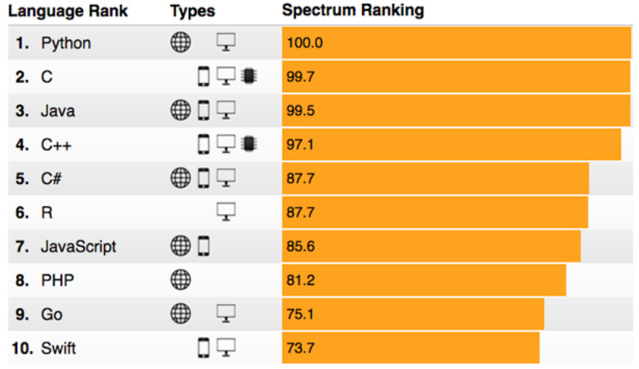
Software for Data Analysis: The R Programing Language
2017 IEEE Spectrum’s Ranking of Programming Languages
2016
2017
2015
2014
Notes:
Amazing because not designed as general programming language
Web traffic (e.g. stackoverflow), job ads, books, citations
But gets the job done with least programming effort on data
Most software starts out as convenience tools for the programmer

Slide 15
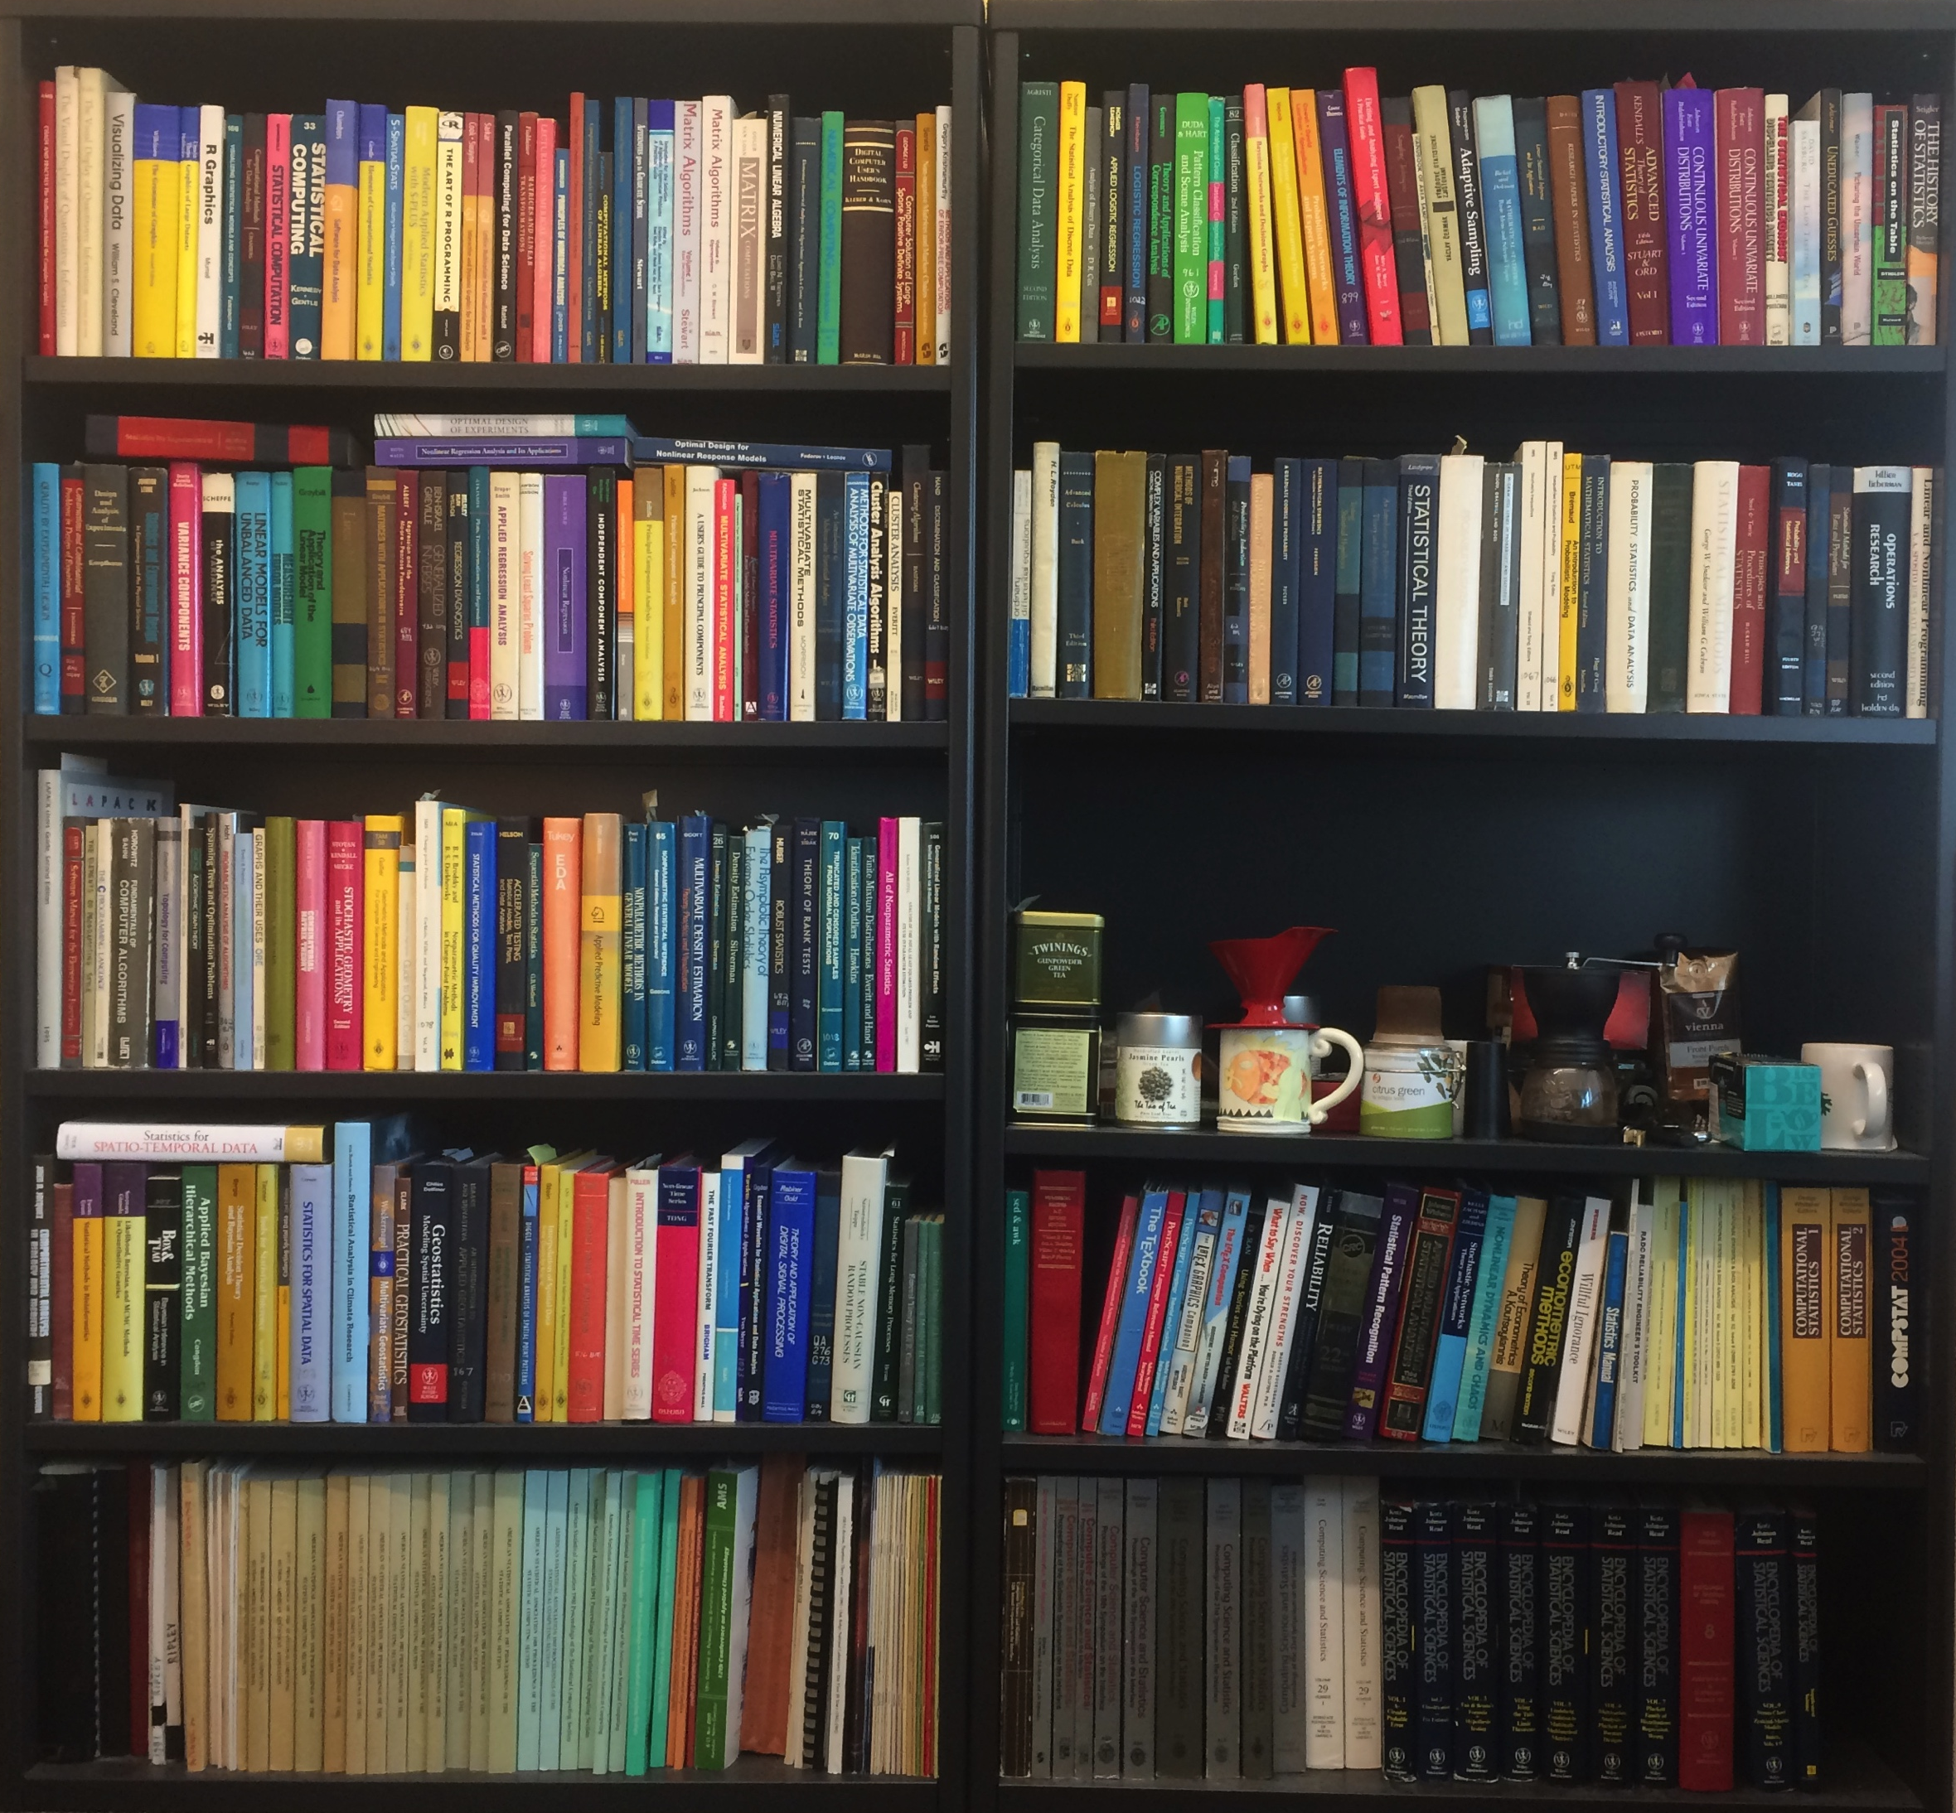
Why R for Big Data? Exploration!
Analytics for not-so-big data:
Science produces great many
Often redundant and related
Statistics and mathematics prune, generalize, and connect
Still, we have hundreds of statistics and mathematics books on data analytics
No reason to expect big data less needy than not-so-big data
Flexibility and a big toolbox are critical for exploration
Notes:
Not-so-big: still have variety, variability, veracity

Slide 16
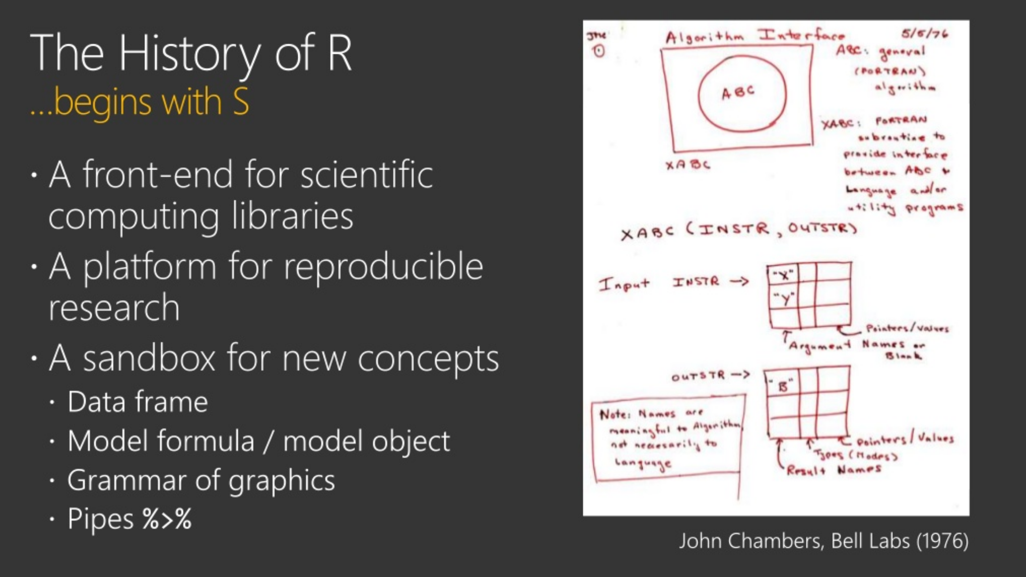


From a blog: April 12, 2018
https://blog.revolutionanalytics.com/2018/04/the-case-for-r-for-ai-developers.html

Slide 17
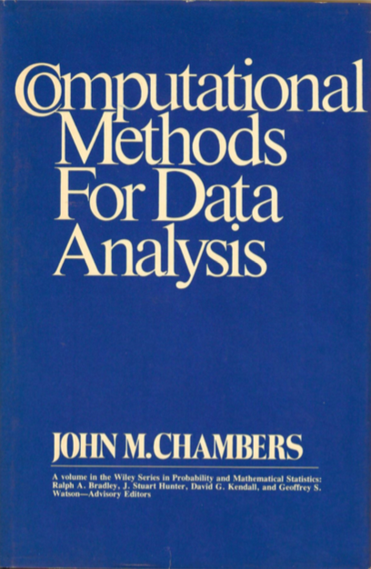
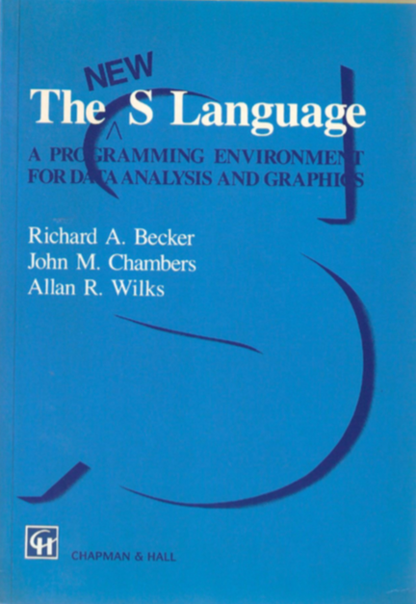
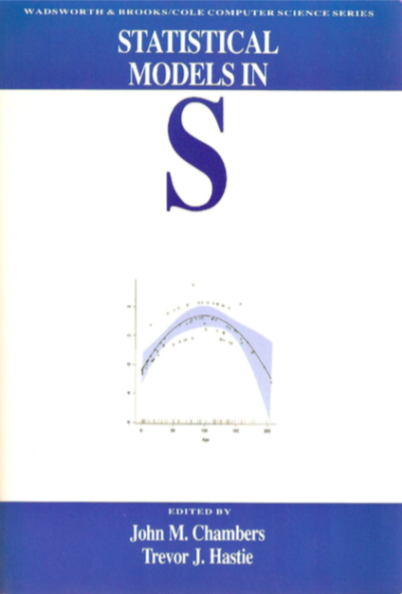
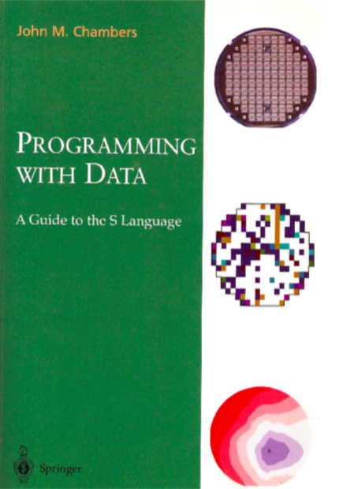
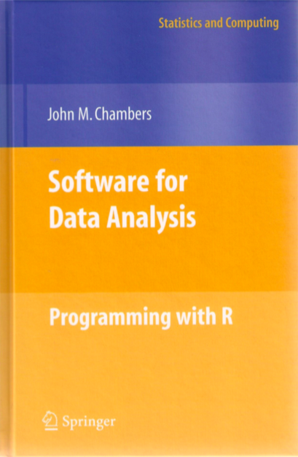
Programming with Data: from Methods to Software
Chambers.
Computational Methods for Data Analysis.
Wiley, 1977.
Becker, Chambers, and Wilks.
The New S Language.
Chapman & Hall, 1988.
Chambers and Hastie. Statistical Models in S. Chapman & Hall, 1992.
Chambers. Programming with Data.
Springer, 1998.
Chambers.
Software for Data Analysis: Programming with R.
Springer, 2008.
Thanks to Dirk Eddelbuettel for this slide idea and to John Chambers for providing the high-resolution scans of the covers of his books.
Notes:
Workflow language for interactive data analysis - Bell Labs 1970s
By 1998 a second version of S was out, licensed by Bell Labs
Chambers and Hastie are Stanford grads and are now at Stanford
By this time, R was out - Robert and Ross - free open source model
Chambers is completely on board with R
Great depth, long vetting of language for data through at leas 3 implementation generations

Slide 18
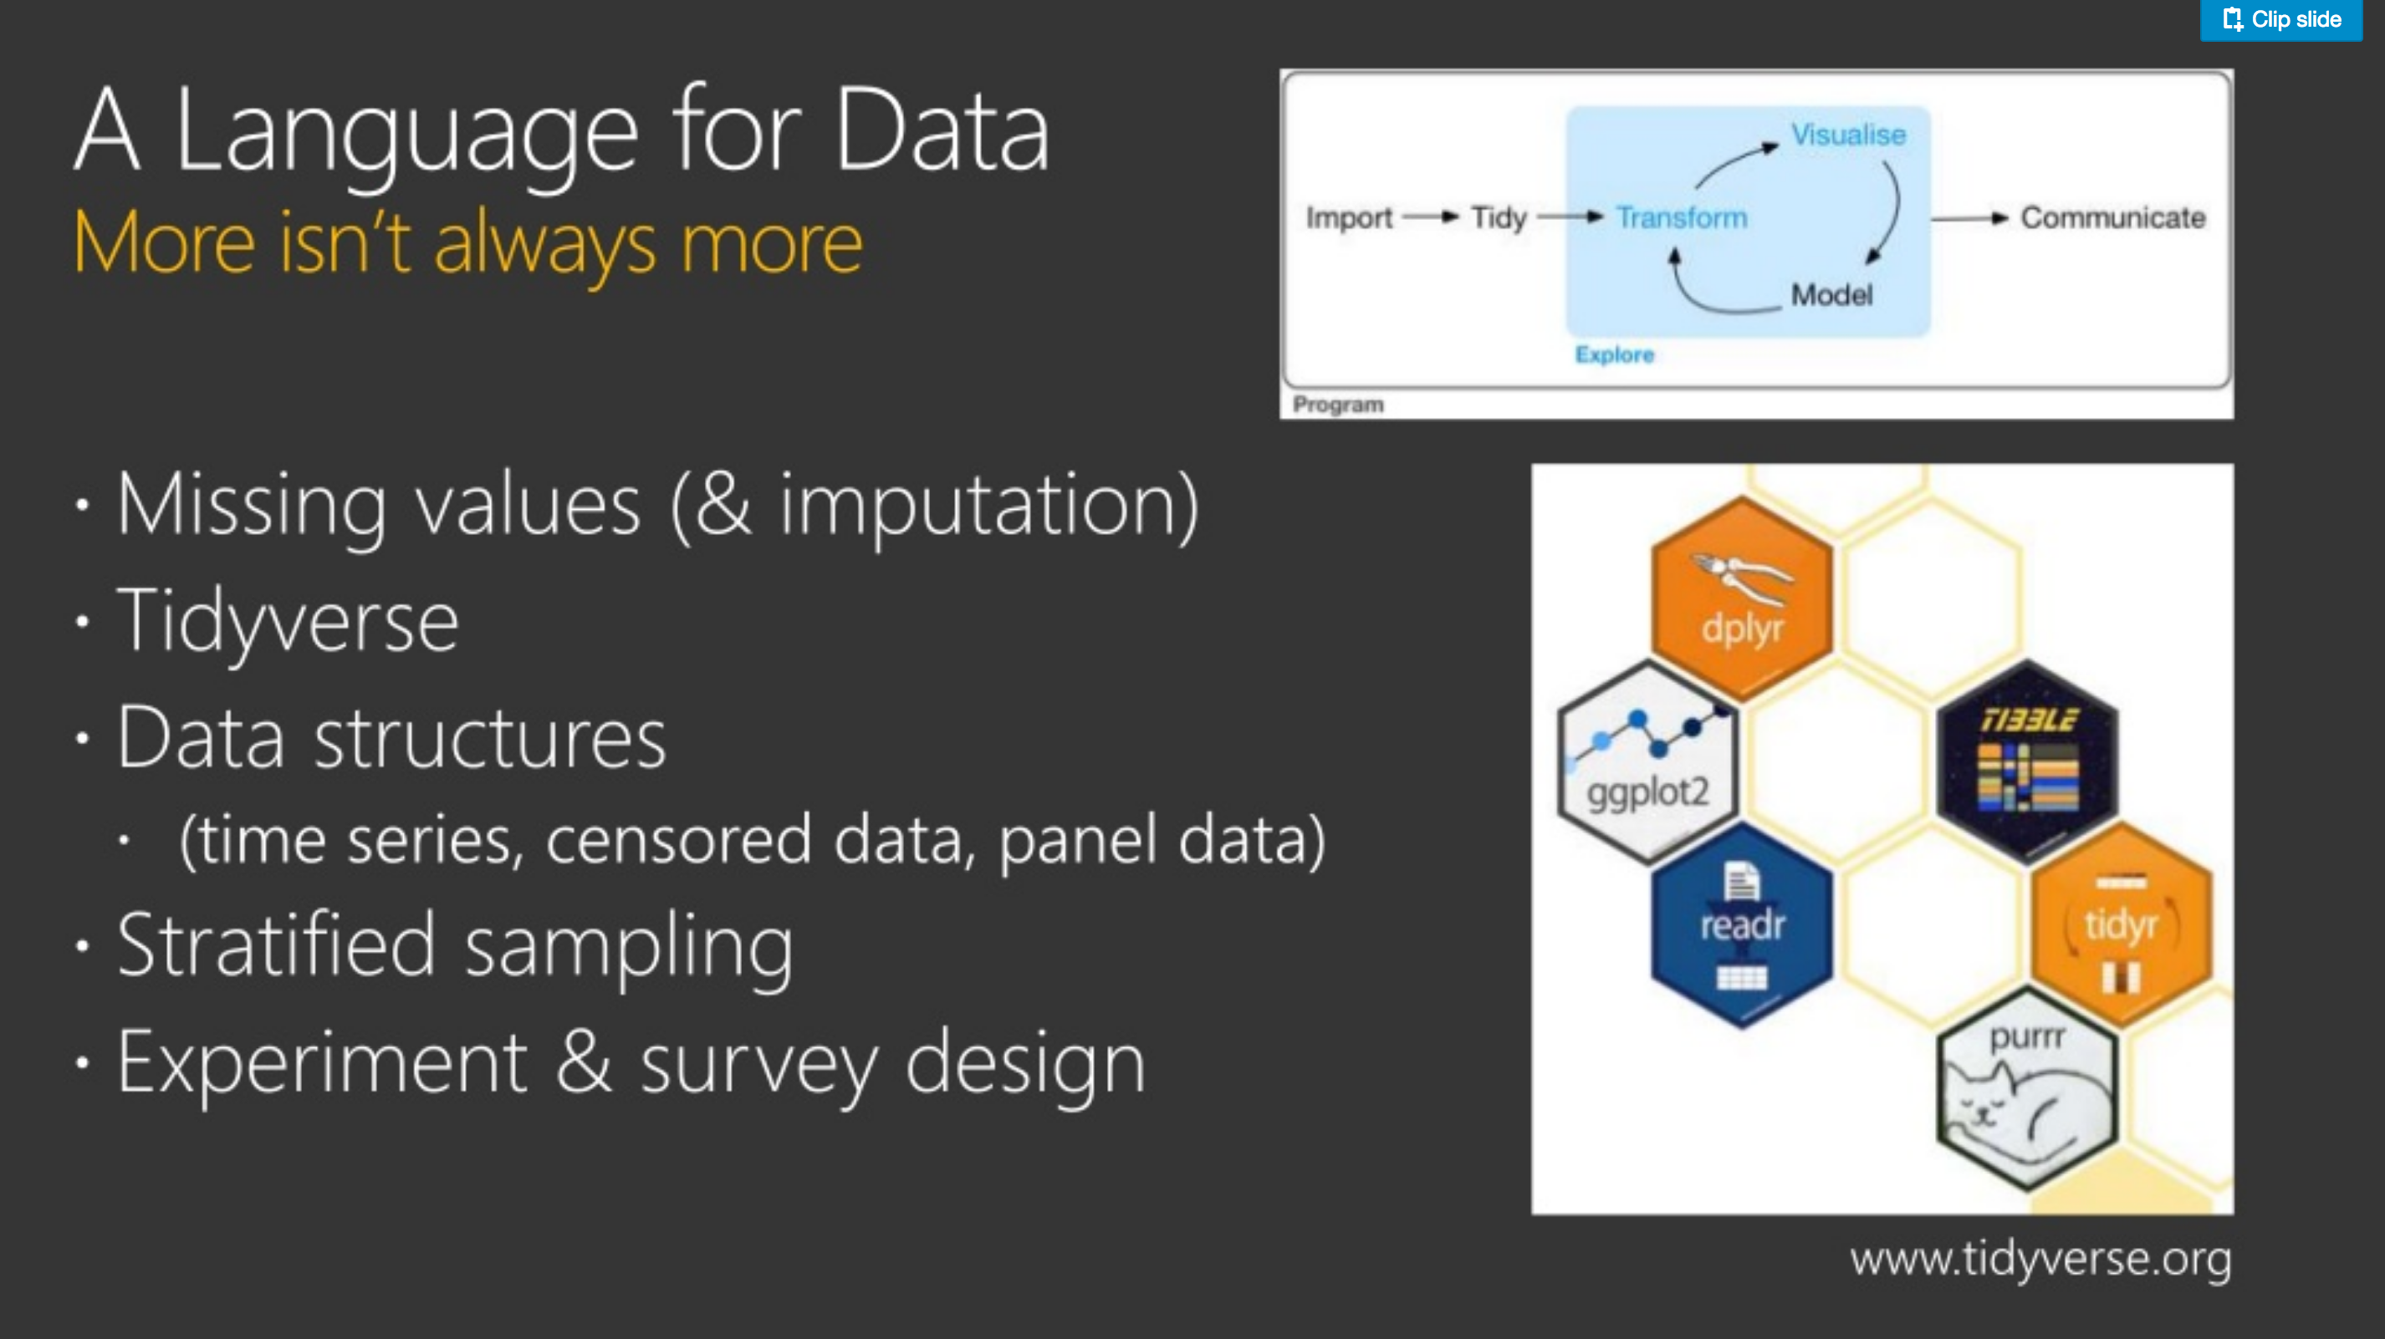
From a blog: April 12, 2018
https://blog.revolutionanalytics.com/2018/04/the-case-for-r-for-ai-developers.html

Slide 19
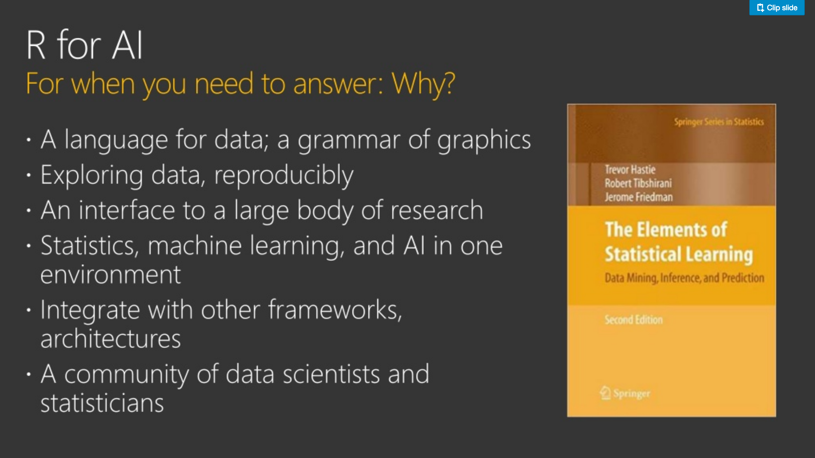
From a blog: April 12, 2018
https://blog.revolutionanalytics.com/2018/04/the-case-for-r-for-ai-developers.html

Slide 20
Statistical Learning or Machine Learning?
Both are about learning from data, some difference in emphasis:
SL: Understanding and discovery: Why?
ML: Processing and prediction
Glossary*
Machine Learning
Statistical Learning
Network, graph . . . . . . . . . . . . . . .
One-hot . . . . . . . . . . . . . . . . . . . . . .
Weights . . . . . . . . . . . . . . . . . . . . .
Learning . . . . . . . . . . . . . . . . . . . . .
Generalization . . . . . . . . . . . . . . . .
Supervised learning . . . . . . . . . . . .
Unsupervised learning . . . . . . . . . .
Model
Dummy variable
Parameters
Fitting
Test set performance
Regression/classification
Density estimation, clustering
* adapted from Rob Tibshirani, Stanford Department of Statistics
Notes:
SL older than ML. But physics older than either!

Slide 21
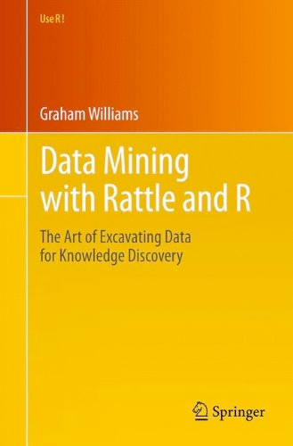
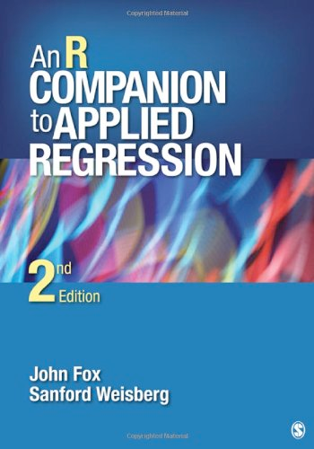

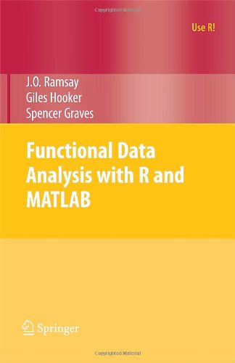
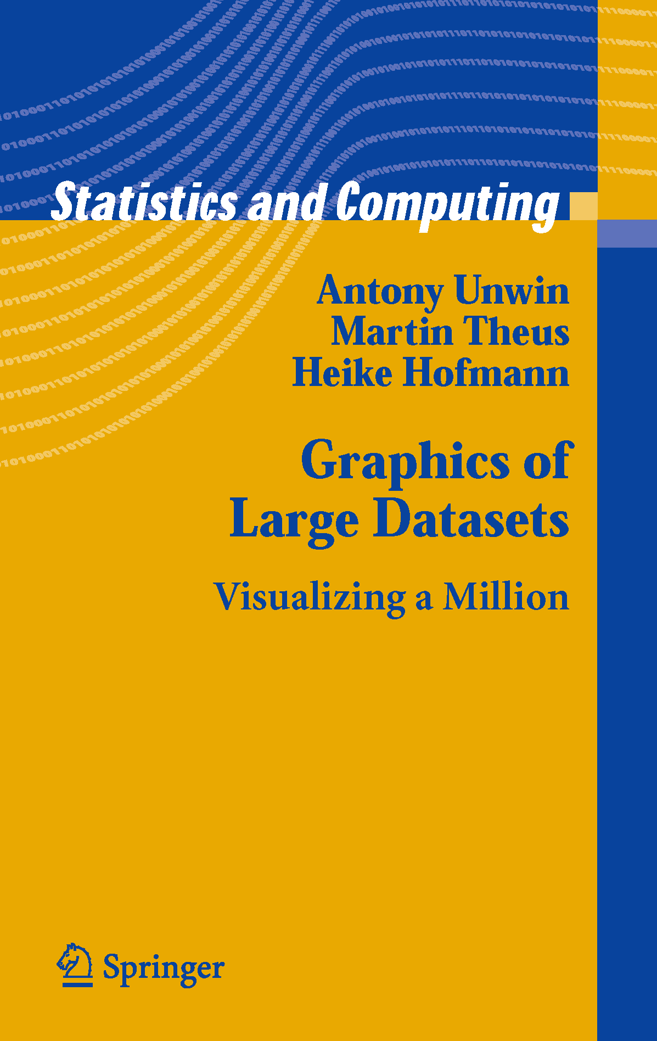
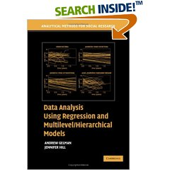
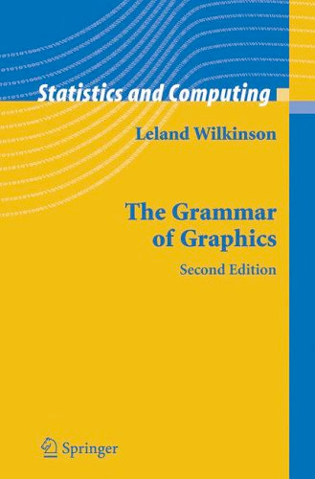


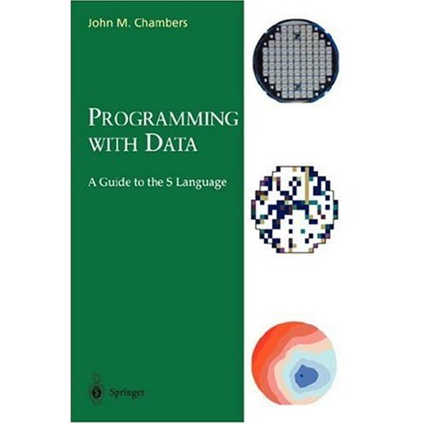
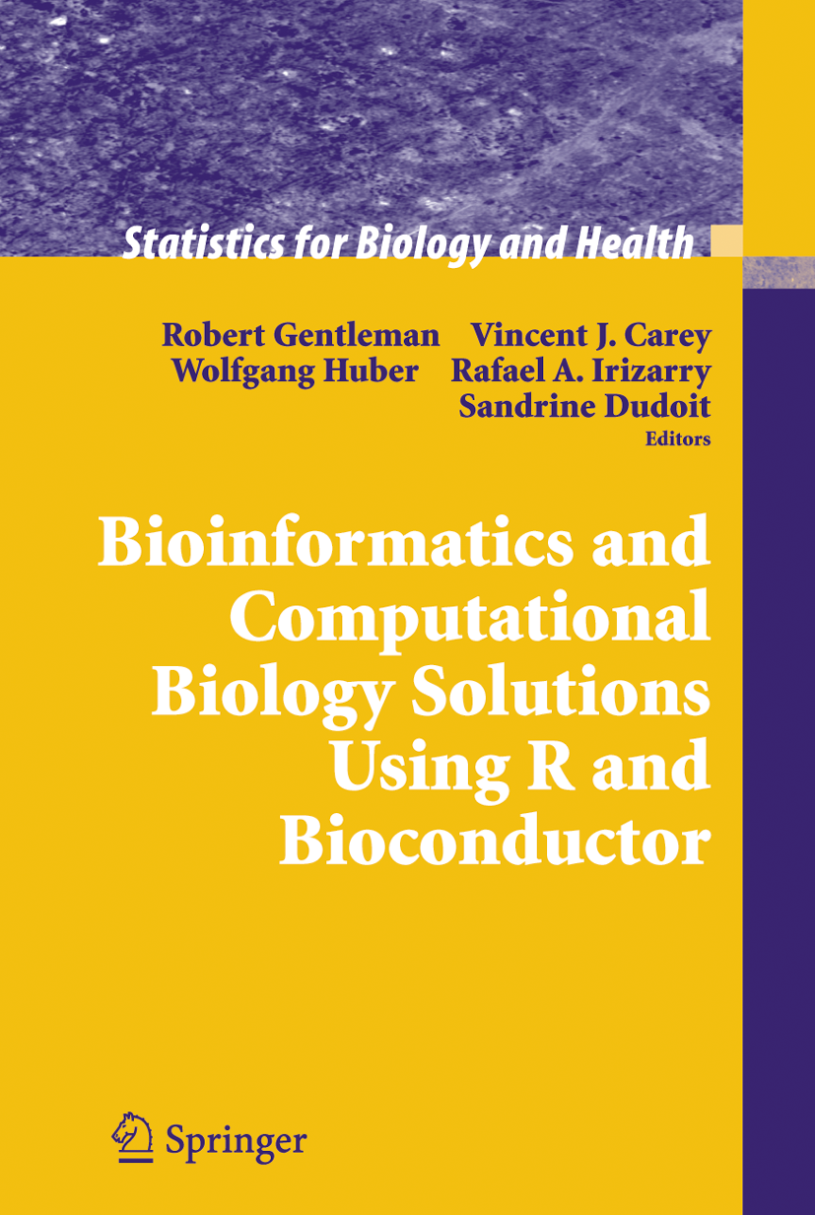
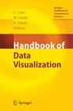

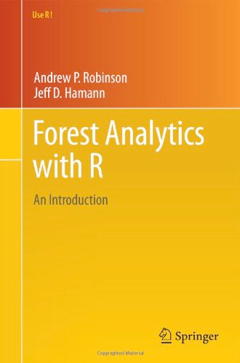
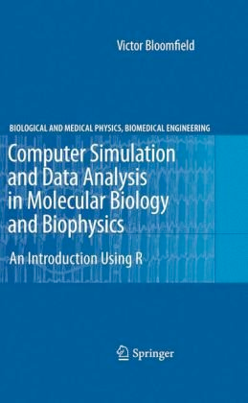
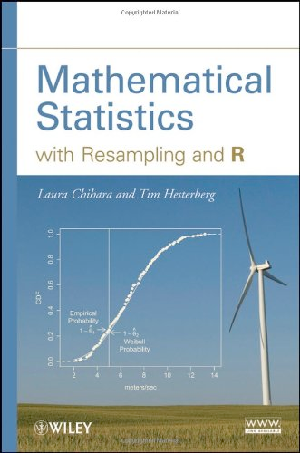

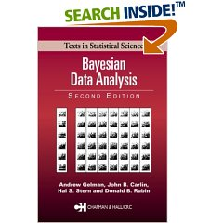
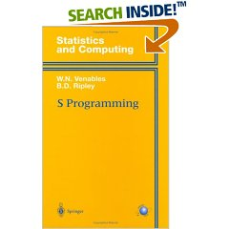

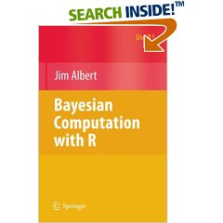
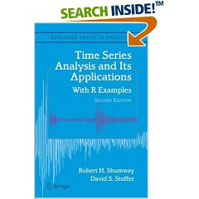
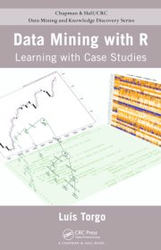


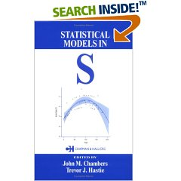

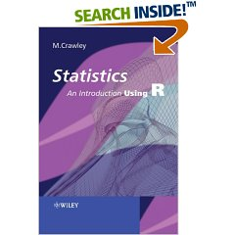
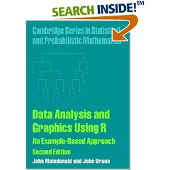

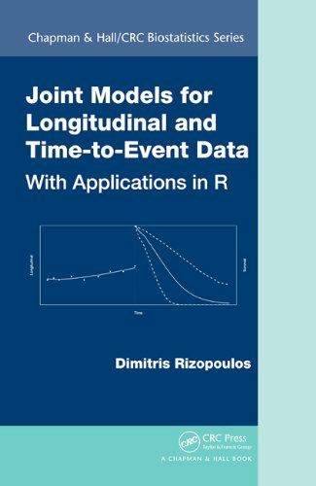

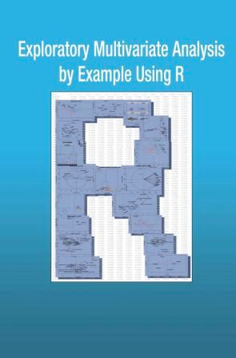
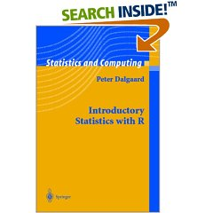
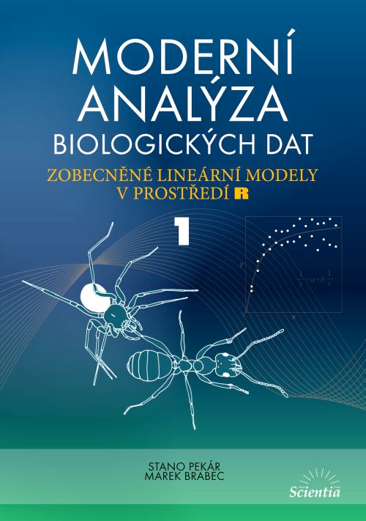



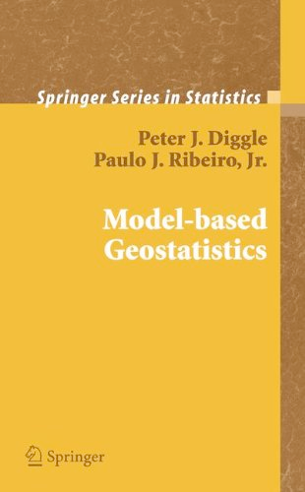
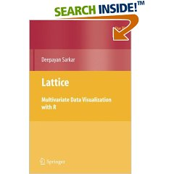

















Unmatched Diversity for Data

Slide 22

Oak Ridge National Laboratory Leadership Computing Facility Supercomputing from Petascale to Exascale
PF = petaflops = 10¹⁵ floating point operations per second
MW = megawatts power consumption at peak

Slide 23



A Highly Scalable R Development Platform for Big Data Analytics
Engage parallel math libraries at scale
R language unchanged
New distributed concepts
New profiling capabilities
New interactive SPMD parallel
In-situ distributed capability
In-situ staging capability via ADIOS
2016 ORNL Significant Event Award
Supported software on OLCF platforms (Rhea, Eos, Titan)
Scalable algorithm engine for ORNL’s BEAM workflow platform
Supporting ORNL’s bioinformatics random forest algorithms
Supporting other DD allocations at OLCF
Algorithm engine under iPLAR (Nanjing University)
http://pbdr.org
HPC libraries and their R/pbdR connections
July 6, 2016
“OLCF Researchers Scale R to Tackle Big Science Data Sets”
“for situations where one needs interactive near-real-time analysis, the pbdR approach is much better [than Apache Spark–like frameworks].”
PCA of a 134 GB matrix: “hours on . . . Apache Spark, . . . less than a minute using R.”
Modern statistical algorithm + pbdR infrastructure
+ HPC Libraries + HPC Hardware
Schmidt, Chen, Matheson, and Ostrouchov (2016). Programming with BIG Data in R: Scaling Analytics from One to Thousands of Nodes, Big Data Research, in print online.
Schmidt, Chen, and Ostrouchov (2016). Introducing a New Client/Server Framework for Big Data Analytics with the R Language. XSEDE16 Conference on Diversity, Big Data, and Science at Scale.

Slide 25
Myth and Reality in Distributed Data Computing
Myth: data computing is different from scientific computing
Reality: The business community and the research community have different data environments but data analysis concepts are the same
The future holds an integration of the HPC and Cloud environments
Business / Data Processing
Research / Scientific Computing
Cloud
Spark/Shuffle
Changing Data Customer Demand
Planned Data
HPC
MPI
Planned
Data
Changing Data Demand
Notes:
Now a Cultures perspective
Classical unbalanced proportions in the respective populations

Slide 26
and Big Data
Adapted From a blog: April 12, 2018
https://blog.revolutionanalytics.com/2018/04/the-case-for-r-for-ai-developers.html

Slide 27
Unmatched Diversity for Data

Slide 28
RStudio Introduction

